Slide 2
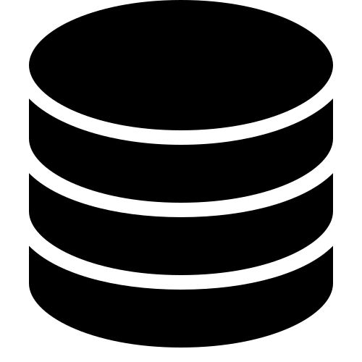
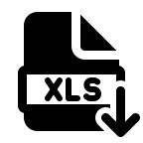



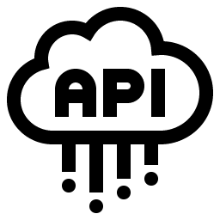


Data Management
Data Catalog
Data Glossary
Data Lineage
monitoring
Discovery
Data Warehouse
Relational/operational data
Visualization
Data Lakehouse
Bronze
SQL/NoSQL DBs
RAW
Batch data
Silver
Cleaned
Machine Learning
Gold
Events/streaming data
Modelled
Source
Ingestion
Storage/Serve
Consumption
Orchestration

Slide 3

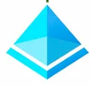
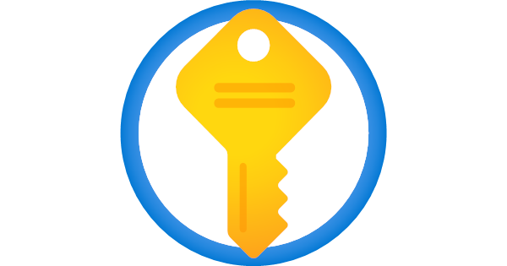
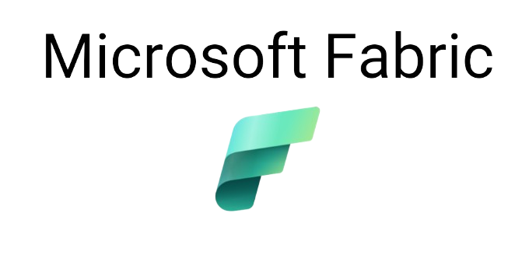
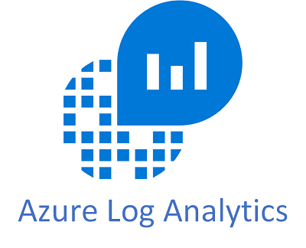


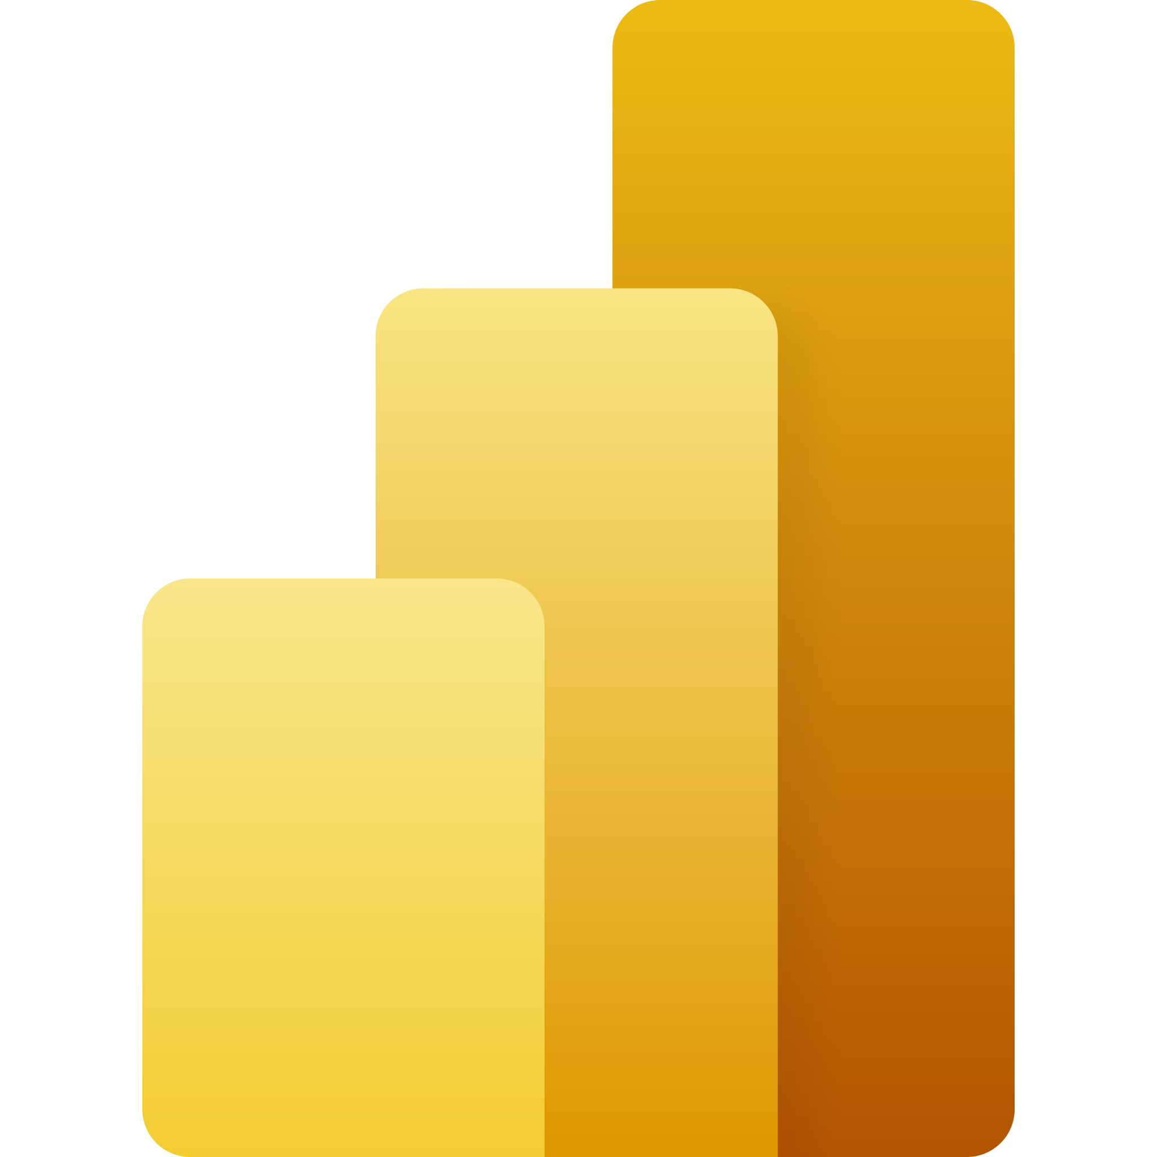

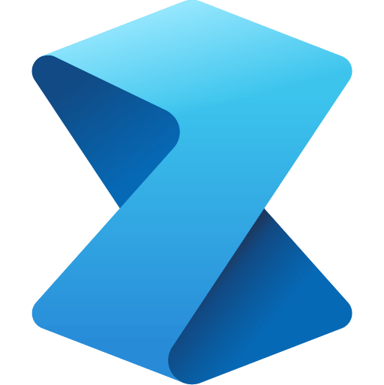


Data Management
Purview
Azure AD
Keyvault
monitoring
Discovery
Relational/operational data
Data Warehouse
Visualization
Data Lakehouse
Bronze
SQL/NoSQL DBs
Data Factory
OneLake
Power BI
RAW
Synapse Data Warehousing
Batch data
Silver
OneLake
Cleaned
Machine Learning
Data Factory
Gold
OneLake
Events/streaming data
Modelled
Synapse Real Time Analytics
Synapse Data Science
Cosmos DB
Source
Ingestion
Storage/Serve
Consumption
Orchestration
Data Factory

Slide 4
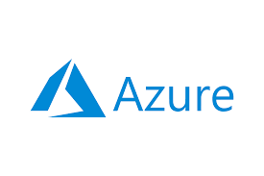

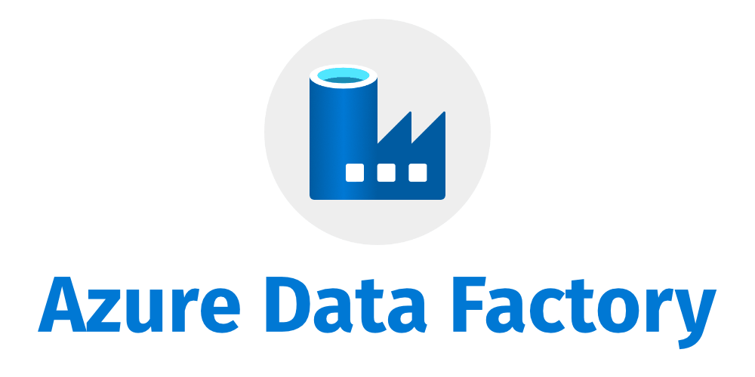
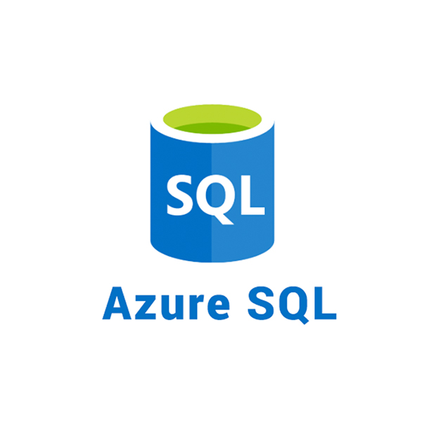
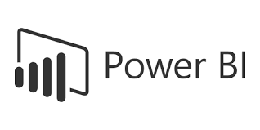
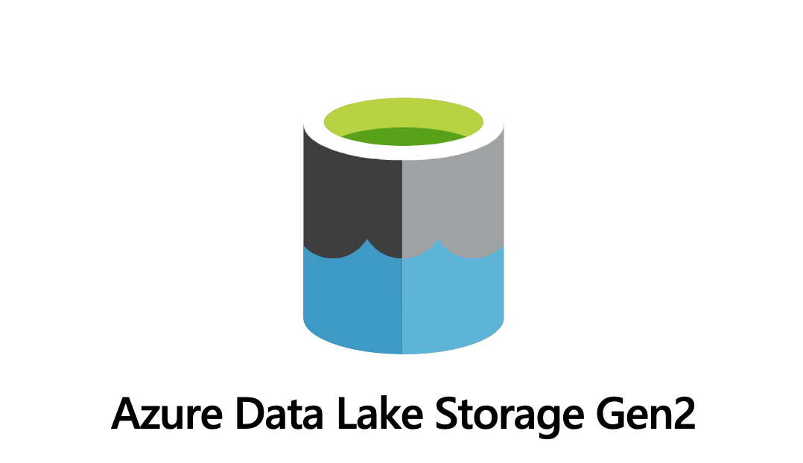
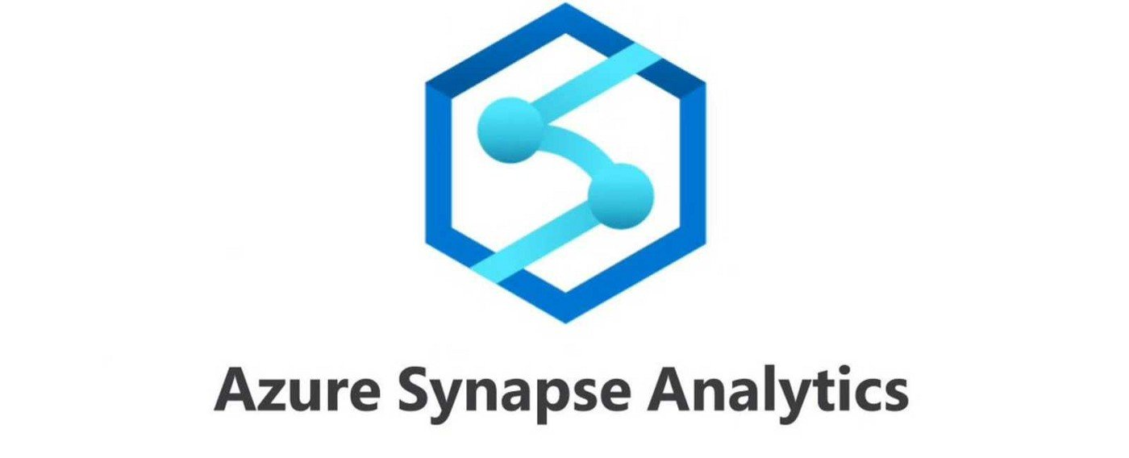

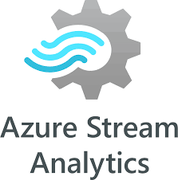
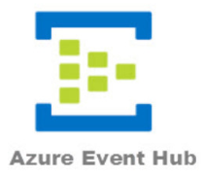
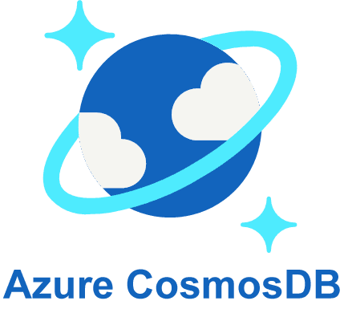
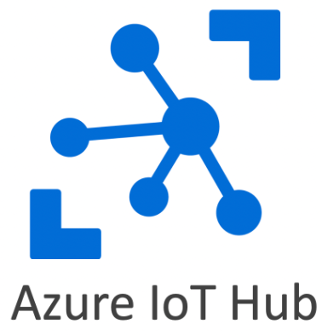
Data Management
Data Catalog
Data Glossary
Data Lineage
monitoring
Discovery
Relational/operational data
Data Warehouse
Visualization
Data Lakehouse
Bronze
SQL/NoSQL DBs
RAW
Batch data
Silver
Cleaned
Machine Learning
Gold
Events/streaming data
Modelled
Source
Ingestion
Storage/Serve
Consumption
Orchestration

Slide 5
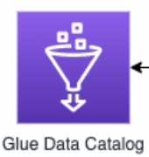


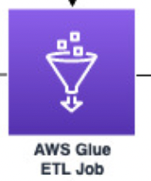


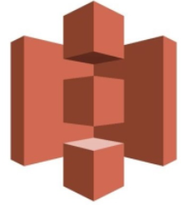
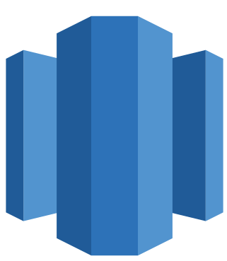

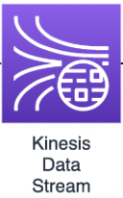
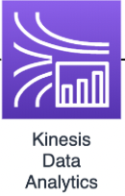
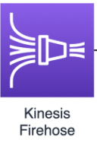
Data Management
Data Catalog
Data Glossary
Data Lineage
monitoring
Discovery
Relational/operational data
Data Warehouse
Visualization
Data Lakehouse
Bronze
SQL/NoSQL DBs
S3
RAW
Redshift
Batch data
Silver
S3
Cleaned
Machine Learning
Gold
S3
Events/streaming data
Modelled
Source
Ingestion
Storage/Serve
Consumption
Orchestration

Slide 6

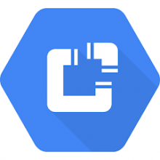
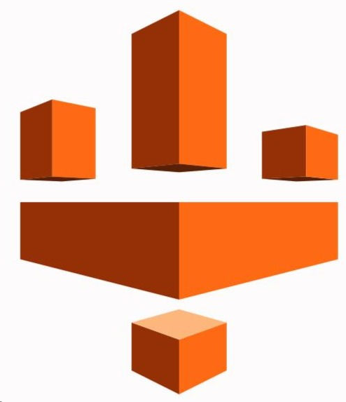
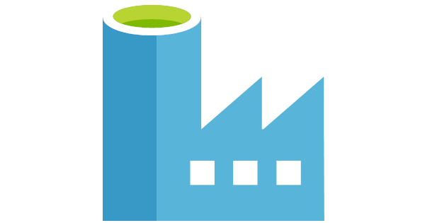


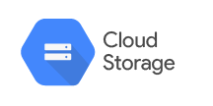
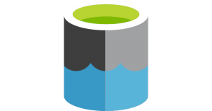


Data Management
Data Catalog
Data Glossary
Data Lineage
monitoring
Discovery
Relational/operational data
Data Warehouse
Visualization
Data Lakehouse
Bronze
SQL/NoSQL DBs
RAW
Batch data
Silver
Cleaned
Machine Learning
Gold
Events/streaming data
Modelled
Source
Ingestion
Storage/Serve
Consumption
Orchestration

Slide 7


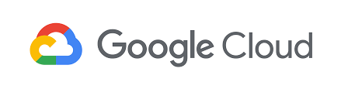




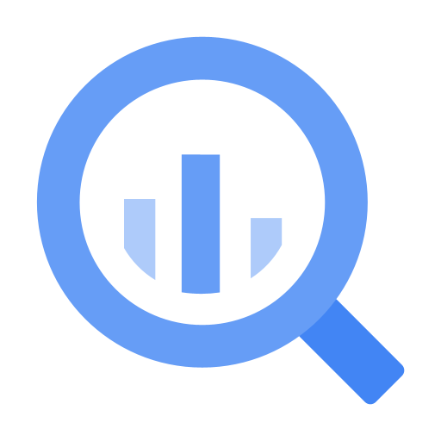








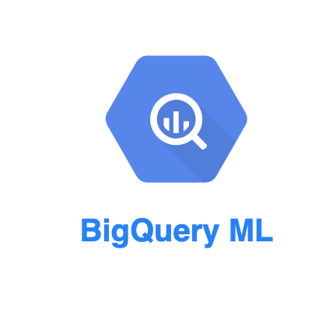



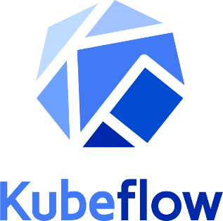

Data Management
Data Catalog
Data Glossary
Data Lineage
Data Catalog
monitoring
Dataplex
Cloud Monitoring
Discovery
Dataprep (Trifacta)
Cloud Logging
Relational/operational data
Data Warehouse
Cloud functions
BigQuery
Visualization
Data fusion
Vertex AI Model Monitoring
Dataflow
Data Lakehouse
Data Studio
Dataproc
Bronze
SQL/NoSQL DBs
Cloud storage
PubSub
Looker
RAW
Batch data
Cloud functions
Silver
Data fusion
Cloud storage
Dataflow
Cleaned
Machine Learning
Machine Learning
Dataproc
PubSub
Gold
Vertex AI
Cloud storage
Events/streaming data
Cloud functions
Modelled
AutoML
Data fusion
Dataflow
BigTable
Dataproc
PubSub
Source
Ingestion
Storage/Serve
Consumption
Orchestration
ML Orchestration
Cloud composer
TensorFlow
Extended

